Slide 1
12.2 (Part A) Hypothesis Tests Goals
Be able to determine if there is an association between the response and explanatory variables using the F test.
Be able to perform inference on the slope (Confidence interval and hypothesis test).
Notes:
The second part of Section 12.2 is concerning inference. This is listed as Part A because it is first in the chapter.
We will be discussion two different hypothesis tests and the confidence interval for the slope. The confidence interval is not in the book.

Slide 2
Simple Linear Regression Model
Let (x_{i}, y_{i}) be pairs of observations. We assume that there exists constants β₀ and β₁ such that
Y_{i} = β₀ + β₁X_{i} + ε_{i}
where ε_{I} ~ N(0, σ²)
iid
Notes:
Before we start this section, I would like to review what we have covered previously.
In linear regression, we have n pairs of observations that fit a linear model y = beta naught plus beta 1 x plus the error term for each point. The error terms are iid normal with mean 0 and variance sigma squared.

Slide 3
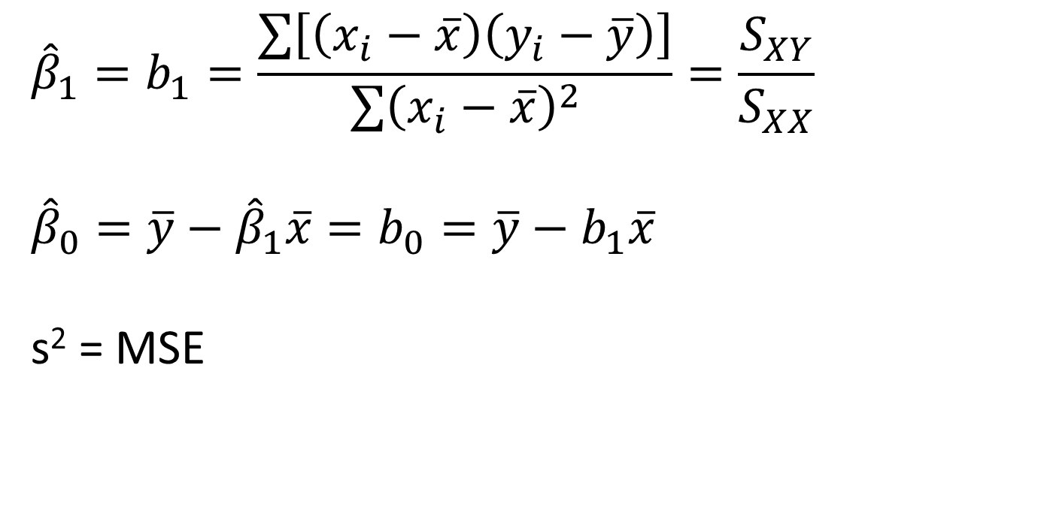
Linear Regression Results
$${\hat{β}}_{1}=b_{1}=\frac{\sum{\left[\left(x_{i}−\overline{x}\right)\left(y_{i}−\overline{y}\right)\right]}}{\sum{{\left(x_{i}−\overline{x}\right)}^{2}}}=\frac{S_{XY}}{S_{XX}}$$
$${\hat{β}}_{0}=\overline{y}−{\hat{β}}_{1}\overline{x}=b_{0}=\overline{y}−b_{1}\overline{x}$$
s² = MSE
Notes:
How do we estimate the parameters in the model?
b1 which is Sxy over Sxx estimates beta 1. Remember that you calculate Sxy and Sxx from the sums.
b0 which is y bar – b1 x bar estimates beta naught.
MSE estimates the variance.
In this section, we will continue with the cetane vs. iodine example which was started in video 12.bd1.

Slide 4
Inference
Association
Intercept
b₀ is an unbiased estimator for β₀
slope
b₁ is an unbiased estimator for β₁
Notes:
Now, we are ready to start discussing inference. What questions can we address using inference?
[a]Is there a linear association between X and Y?
Normally we are not interested in the intercept, beta 0, which is the value of y when x is 0. The book does discuss this inference, however, we are skipping that part of the book. [a]b0 is an unbiased estimator for beta 0. Note that [not in video: in] my terminology [not in video: I] use a lower case b, not beta hat or an upper case B.
What can we look for in the slope? Is the slope positive or negative? We can also determine if there is an association between X and Y by looking at the slope. If the slope is 0, then there is no association. [not in the video: If the slope is 0, that means it is a horizontal line so there is no way to predict y from x.] [a]b1 is an unbiased estimator for beta 1.

Slide 5
Assumptions
SRS
linearity
Constant standard deviation of residuals
Normality
If the residuals are normal then y is normal
If y is normal, then both b₀ and b₁ are normal
If y is not normal, there is still CLT
Notes:
I have mentioned what the assumptions are earlier, but I want to remind you what they are here. [re-worded from video: We have already shown how to determine if they] are valid in Section 12.4.
As always, we have SRS, in this case, the pairs are SRS and are independent from each other.
Since this is based on linear regression, we have the linearity assumption. Just remember, that if the form is not linear, then inference concerning it is not valid.
Since we are assuming that the residuals are iid, we have to have a constant variance.
In the derivation, we assume that the residuals are normal. This implies that the response variable is also normal. Even though this is not an average, CLT still holds for both the slope and the intercept. In fact these are robust toward normality.
Remember that outliers and influential observations invalidate inference because they invalidate the assumptions involved in linear regression. [not in video: Note that you can only perform any inference if the assumptions are valid.]

Slide 6
Association
model linear regression: y_{i} = β₀ + β₁x_{i} + ε_{i}
E(y_{i}) = β₀ + β₁x_{i}
model ANOVA: X_{ij} = μ_{i} + ε_{ij}
H₀: there is no association between X and Y
H_{a}: there is an association between X and Y
Notes:
The linear regression model is y sub i = beta naught plus beta 1 x i plus epsilon sub i.
[a]Since the expectation of y sub i is beta naught plus beta 1 x sub i, [a]you can compare this derivation to the ANOVA model. Here, mu sub i can be mapped to beta naught plus beta 1 x sub i and the error terms are mapped to each other.
[a]In this case, the status quo would be no association and what we are trying to show is that there is an association. These statements are always in words.

Slide 7
F test statistic
$$F=\frac{variance due to the model}{variance due to the residuals}=\frac{MSR}{MSE}$$
Notes:
The test statistic is going to compare the variance due to the model to the variance due to the residuals or error.
In this case, the variance due to the model is related to the spread on the y-axis which is related to the slope.
If the test statistic is large, then most of the variance in the response variable is due to the model so there is an association between X and Y. This means that there is a ‘large’ slope.
If the test statistic is small, then the variance due to the model is around the same or less than the variance due to the residuals so the slope is approximately equal to 0 or there is no association.

Slide 8
ANOVA table for Linear Regression
Source | df | SS | MS | F
Regression | 1 | Σ(ŷ_{i} - ȳ)² = b₁S_{XY}
Error | n – 2 | Σ(y_{i} - ŷ_{i})² = SSE - SSR
Total | n – 1 | Σ(y_{i} - ȳ)² = S_{YY}
df1 = dfr = 1
df2 = dfe = n - 2
Notes:
This is the same ANOVA table that was provided in Section 12.1
Again, we have two degrees of freedom for the F test statistic, df1 = dfr which is always 1 and df2 = dfe = n – 2. Please see previous videos for the formulas to calculate SSR, SSE, and SST from the given values.
The F test is called the model utility test. The book states that if we reject H0 then the coefficient of determination, r squared, is large. However, this is misleading. The association really works in the other direction. That is if R2 is large, then H0 will be rejected. However, it is possible to have a significant F test with a low coefficient of determination. For example in ecology, it is quite common to encounter significant regressions with r squared < 0.2 and sometimes even less than 0.1. Most of these are examples of bad statistical practice like having influential outliers, but many are real effects in very noisy systems.

Slide 9
LR Hypothesis Test: Summary
H₀: there is no association between X and Y
H_{a}: there is an association between X and Y
Test statistic: F_{ts} $=\frac{MSR}{MSE}$
P-value: P = P(F > F_{ts}), df1 = dfr = 1, df2 = dfe = n – 2
pf(Fts,df1,df2,lower.tail=FALSE)
Table.lm <- lm(YVar~XVar, data = Table)
Summary(Table.lm)
Notes:
This is the summary slide for the model utility test.
For this test, there is no ‘step 1’, because there are no parameters. The hypotheses are only in words. It does not matter whether X is first or Y is first in the statement for the hypothesis. However, you do have to explicitly state what X and Y are in context. The F test statistic is generated from the ANOVA table. The same code is used to calculate the p value for the F test statistic as with ANOVA.
[a]If you have the data, the code to calculate the test statistic, degrees of freedom, and the p-value is shown here. This code is explained in more detail in Computer Assignment 9b.

Slide 10
Example: LR - Inference
The cetane number is a critical property in specifying the ignition quality of a fuel used in a diesel engine. Determination of this number for a biodiesel fuel is expensive and time-consuming. Therefore a way of predicting this number is wanted. The data on the next slide is x = iodine value (g) and y = cetane number for a sample of 14 biofuels. The iodine value is the amount of iodine necessary to saturate a sample of 100g of oil.
Perform the hypothesis test using the F test statistic (the model utility test)
Notes:
Example Optional Model Utility Test.
This is the same situation as before.
f) Perform the hypothesis test using the F test statistic (the model utility test)

Slide 11
Example: LR - Inference
H₀: there is no association between cetane number and iodine value.
H_{a}: there is an association between cetane number and iodine value.
Notes:
There are no parameters, so you do not need to include Step 1.
[a]Step 2: the null hypothesis is that there is no association between iodine value and cetane number [not in video: cetane number and iodine value]. The alternative hypothesis is that there is an association between iodine value and cetane number [not in video: cetane number and iodine value]..

Slide 12
Example: LR – Inference - ANOVA
Analysis of Variance
Source | df | Sum of Squares | Mean Square | F Value | Pr > F
Model | 1 | 298.254 | 298.254 | 45.35 | 2.091e-5
Error | 12 | 78.920 | 6.577
Corrected Total | 13 | 377.174
F_{ts} = 45.35, df1 = 1, df2 = 12
pf(45.35,1,12,lower.tail=FALSE)
[1]2.090629e-5
Notes:
This is the same ANOVA table that was displayed previously.
[a]Step 3: The test statistic is 45.35. The numerator degrees of freedom is always 1, in this case the denominator degrees of freedom is 12.
[a]Since I am using the results from SAS and the p value is very small, we only know that it is less than 0.0001. [not in video: the code to calculate the p-value is shown here. The value is: 2.091 x 10^-5.

Slide 13
Example: LR – Inference (cont)
p = 2.091 x 10⁻⁵
reject H₀ 2.091 x 10⁻⁵ < 0.05
The data does provide strong support (p = 2.091 x 10⁻⁵ ) to the claim that there is a linear relationship between iodine value and cetane number.
Notes:
Step 4: The decision is reject H₀ because 0.0001 [2.091 x 10^-5] < 0.05
[a]Therefore, the data does provide strong support (p =[ 2.09 x 10^-5]) to the claim that there is a linear relationship between iodine value and cetane number.

Slide 14
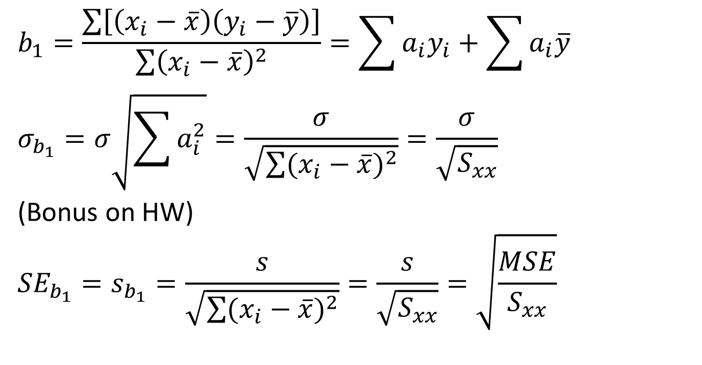
Standard deviation for b₁
$$b_{1}=\frac{\sum{\left[\left(x_{i}−\overline{x}\right)\left(y_{i}−\overline{y}\right)\right]}}{\sum{{\left(x_{i}−\overline{x}\right)}^{2}}}=\sum{a_{i}y_{i}}+\sum{a_{i}\overline{y}}$$
$$σ_{b_{1}}=σ\sqrt{\sum{a_{i}^{2}}}=\frac{σ}{\sqrt{\sum{{(x_{i}−\overline{x})}^{2}}}}=\frac{σ}{\sqrt{S_{xx}}}$$
(Bonus on HW)
$${SE}_{b_{1}}=s_{b_{1}}=\frac{s}{\sqrt{\sum{{(x_{i}−\overline{x})}^{2}}}}=\frac{s}{\sqrt{S_{xx}}}=\sqrt{\frac{MSE}{S_{xx}}}$$
Notes:
Since both of the parameters, b0 and b1 have normal distributions, we can again use the standard normal distribution for our calculations. Remember that even though the book discusses both b0 and b1, we will only be discussing the slope in class. We will not be calculating any inference for the y-intercept.
Since we are going to standardize the distribution, we need to know what is the estimated value and the standard deviation of the estimated value. [a]The estimator for beta 1 is b1 which we have already calculated. What is sigma sub b1? The book gives the value, I will be going over a brief derivation.
Remember that we are assuming that the only randomness is in epsilon sub i and we have a constant standard deviation for all y sub i’s which is sigma.
[a]We know that b1 is the sum shown here. This can be rearranged to the summation over all of the data points of a sub i y sub i where a sub i depends on the constants x sub i and the average values of x and y. Because in the next step, we will be taking the standard deviation of b1, I have not included the translation term in the summation. [not in video: the translation term is the summation of a sub i times y bar.
Since the a sub i’s are fixed and all of the y sub i’s have the same standard deviation, sigma, [a]we know that sigma sub b1 is sigma times the square root of the summation of the a sub i’s squared. This can be shown using the rules of variance. [a]Plugging in what the a sub i’s are implies that sigma sub b sub 1 is sigma over the square root of Sxx. A bonus on the homework is to show that the square root of the squares of a sub i’s is the same as 1 over the square root of Sxx.
[a]Finally the standard error of b1 is the estimate of this value, so we replace sigma with s. Since we know that s equals the square root of MSE, we have the following formula for the standard error of b1.
This has a t distribution (because b1 is normal) with the same degrees of freedom as MSE or dfe = n – 2.

Slide 15

Confidence Interval for β₁
$b_{1}±t_{α/{2,df}}{SE}_{b1}$ =
$$b_{1}±t_{α/{2,n−2}}\sqrt{\frac{MSE}{S_{xx}}}$$
SE <- sqrt(MSE/Sxx)
confint(Table.lm, level = 0.95)
Notes:
Since we know the standard error for b1, we can write down the confidence interval for the slope. This is b1 plus or minus the critical value times the standard error of b1 which is b1 plus or minus t with alpha over 2 and degrees of freedom, n – 2 times the square root of MSE over Sxx. When we state the interpretation of this, remember it is for the population slope between y versus x, not the mean value.
[a][not in video: If you don't have the data, the only different between this confidence interval and the ones that we had before is you define SE as provided. Remember that the estimatated value is now b1 instead of xbar.
[a]If you know the data, the function for the confidence interval is confint() where the first parameter is the previously defined output for the linear regression.

Slide 16

LR Hypothesis Test: Summary
Null hypothesis: H₀: β₁ = β₁₀ = 0
Test statistic: $\frac{b_{1}−β_{10}}{\sqrt{\frac{MSE}{S_{xx}}}}$
Note: A two-sided test with β₁₀ = 0 is the F test
 | Alternative Hypothesis | P-Value
Upper-tailed | H_{a}: β₁ > β₁₀ (0) | P(T ≥ t)
Lower-tailed | H_{a}: β₁ < β₁₀ (0) | P(T ≤ t)
two-sided | H_{a}: β₁ ≠ β₁₀ (0) | 2P(T ≥ |t|)
Notes:
The results for the hypothesis test for beta 1 is shown here.
In the book, the null value is beta 1 0, this is a 0 after a 1, not beta sub 10. When beta 1 0 is zero, then this is the same as the F test.
We calculate the p values as before with the degrees of freedom being dfe which is n – 2.
[a]Usually, we will be testing the null hypothesis of beta 1 equals 0. with an alternative hypothesis of the beta 1 is not equal to 0. This set of hypotheses is for the question of whether the variables are linearly associated or not. Remember what happens when the slope is 0? This means that Y is not associated with X because all values of X have similar Y values. Therefore, there is no linear association between X and Y. This test of H₀: beta 1 = 0 and H_{a:} beta 1 not equal 0 is the F test or model utility test. [a]However, there are cases when you are interested if there is a positive slope, H_{a}: beta 1 greater than 0 or negative slope, H_{a}: beta 1 is less 0. In addition, if the slope has physical meaning, you can test whether the slope is the same as a certain value with the appropriate alternative hypothesis.
In ANOVA, we stated that the F test is identical to the t test when k = 2. If k = 2 then df1 = 1. This is universally true. That is, if df1 = 1, the F test is the same as the t test if all of the other conditions are met and df2 is the degrees of freedom of the t test. When we do this in Lab [Computer Assignment] 9b, you will see that the p values are identical for the F test and the t test and the value of the F test statistic is the t test statistic squared. [not in video: The output will be explained in that computer assignment.]
So why do we even mention the F test when it is identical to the t test?
If you are doing inference on multiple regression, df1 is no longer identical to 1. This value is the number of parameters of the line minus 1. Therefore, the F test is not identical to the t test and does mean something different. We will only be briefly discussing this in this course [not in video: in Section 12.5] because of the limited time that we will be spending on multiple regression. However, it will be discussed in 512 if you are a STAT major or minor.
An optional example follows.

Slide 17

LR Hypothesis Test: Summary
Null hypothesis: H₀: β₁ = β₁₀ = 0
Test statistic: $\frac{b_{1}−β_{10}}{\sqrt{\frac{MSE}{S_{xx}}}}$
Note: A two-sided test with β₁₀ = 0 is the F test
 | Alternative Hypothesis | P-Value
Upper-tailed | H_{a}: β₁ > β₁₀ (0) | P(T ≥ t)
Lower-tailed | H_{a}: β₁ < β₁₀ (0) | P(T ≤ t)
two-sided | H_{a}: β₁ ≠ β₁₀ (0) | 2P(T ≥ |t|)
Notes:
The results for the hypothesis test for beta 1 is shown here.
In the book, the null value is beta 1 0, this is a 0 after a 1, not beta sub 10. When beta 1 0 is zero, then this is the same as the F test.
We calculate the p values as before with the degrees of freedom being dfe which is n – 2.
[a]Usually, we will be testing the null hypothesis of beta 1 equals 0. with an alternative hypothesis of the beta 1 is not equal to 0. This set of hypotheses is for the question of whether the variables are linearly associated or not. Remember what happens when the slope is 0? This means that Y is not associated with X because all values of X have similar Y values. Therefore, there is no linear association between X and Y. This test of H₀: beta 1 = 0 and H_{a:} beta 1 not equal 0 is the F test or model utility test. [a]However, there are cases when you are interested if there is a positive slope, H_{a}: beta 1 greater than 0 or negative slope, H_{a}: beta 1 is less 0. In addition, if the slope has physical meaning, you can test whether the slope is the same as a certain value with the appropriate alternative hypothesis.
In ANOVA, we stated that the F test is identical to the t test when k = 2. If k = 2 then df1 = 1. This is universally true. That is, if df1 = 1, the F test is the same as the t test if all of the other conditions are met and df2 is the degrees of freedom of the t test. When we do this in Lab [Computer Assignment] 9b, you will see that the p values are identical for the F test and the t test and the value of the F test statistic is the t test statistic squared. [not in video: The output will be explained in that computer assignment.]
So why do we even mention the F test when it is identical to the t test?
If you are doing inference on multiple regression, df1 is no longer identical to 1. This value is the number of parameters of the line minus 1. Therefore, the F test is not identical to the t test and does mean something different. We will only be briefly discussing this in this course [not in video: in Section 12.5] because of the limited time that we will be spending on multiple regression. However, it will be discussed in 512 if you are a STAT major or minor.
An optional example follows.

Slide 18
Example: SLR - Inference
The cetane number is a critical property in specifying the ignition quality of a fuel used in a diesel engine. Determination of this number for a biodiesel fuel is expensive and time-consuming. Therefore a way of predicting this number is wanted. The data on the next slide is x = iodine value (g) and y = cetane number for a sample of 14 biofuels. The iodine value is the amount of iodine necessary to saturate a sample of 100g of oil.
What is the 95% Confidence Interval for the population slope?
Is there a useful linear relationship between iodine value and cetane number at a 5% significance level using the slope?
Notes:
Example Optional inference of slope
This is the same example concerning the cetane number versus iodine value. First, I will calculate the confidence interval and then we will perform the hypothesis test for beta 1 [not in video: in the next video].

Slide 19

Example: SLR - CI
What is the 95% Confidence Interval for the population slope?
$$b_{1}±t_{α/{2,n−2}}\sqrt{\frac{MSE}{S_{xx}}}$$
b₁ = -0.209 S_{xx} = 6802.77 α = 0.05
Notes:
g) What is the 95% Confidence Interval for the population slope?
[a]What information do we need to do this calculation?
b1, alpha, n – 2, MSE, Sxx
[a]b1 was calculated earlier and the value of Sxx was also provided earlier. alpha here is 0.05

Slide 20
Example: SLR - CI
Analysis of Variance
Source | df | Sum of Squares | Mean Square | F Value | Pr > F
Model | 1 | 298.254 | 298.254 | 45.35 | 2.091e-5
Error | 12 | 78.920 | 6.577
Corrected Total | 13 | 377.174
b₁ = -0.209 S_{xx} = 6802.77 α = 0.05
MSE = 6.577 n – 2 = 12
Notes:
From the ANOVA table, MSE = 6.577 and n – 2 = 12.

Slide 21
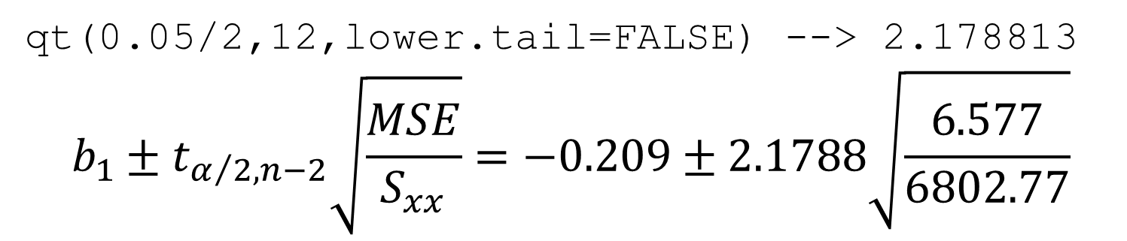

Example: SLR - CI
b₁ = -0.209 S_{xx} = 6802.77 α = 0.05
MSE = 6.577 n – 2 = 12
qt(0.05/2,12,lower.tail=FALSE) --> 2.178813
$$b_{1}±t_{α/{2,n−2}}\sqrt{\frac{MSE}{S_{xx}}}=−0.209±2.1788\sqrt{\frac{6.577}{6802.77}}$$
$$=−0.209±2.1788\left(0.03109\right)$$
$$=−0.209±0.0677⇒(−0.277,−0.141)$$
Notes:
The critical value here is 2.1788. [a]Plugging in the values, we obtain an interval of -0.277 to -0.141.

Slide 22
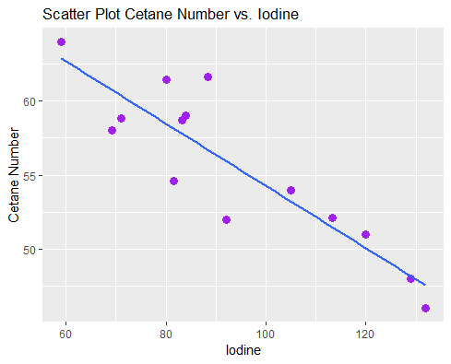
Example: SLR - CI
We are 95% confident that the population slope between cetane number and iodine value is covered by the interval -0.277 to -0.141.
Notes:
Therefore, we are 95% confident that the population slope between cetane number and iodine value is covered by the interval -0.277 to -0.141.
I want to make some comments about this interpretation. Remember, we are not discussing the mean but the slope between the Y and X axes. Since the slope depends on which of the two variables is the explanatory and the response, by convention we state the y first and the x second in context.
What conclusion can be made here? There is an association because 0 is not in the interval. In addition, we can state that the slope has to be negative since only negative numbers are included. [a] This is consistent with the scatterplot.

Slide 23
Example: SLR - HT
h) Is there a useful linear relationship between iodine value and cetane number at a 5% significance level using the slope?
b₁ = -0.209 S_{xx} = 6802.77 α = 0.05
MSE = 6.577 n – 2 = 12
1. β₁ is the population slope for cetane number vs. iodine value
2. H₀: β₁ = 0 H_{a}: β₁ ≠ 0
Notes:
Now we will discuss how to do the hypothesis test. Because there are two methods to calculate the association, we have to state which method should be used. If we don’t make the statement, then either method is appropriate. Therefore, this time we will be using the slope. [a]We are going to need the same constants as before.
[a]Step 1. beta 1 is the population slope for cetane number vs. iodine value. Again, by convention, we state the response variable first.
[a]Step 2. Since we are determining whether there is a linear relationship between the two variables, we have a null value of 0 and the alternative hypothesis is not equal to. This is equivalent to have a null hypothesis of no association and an alternative hypothesis of an association.

Slide 24
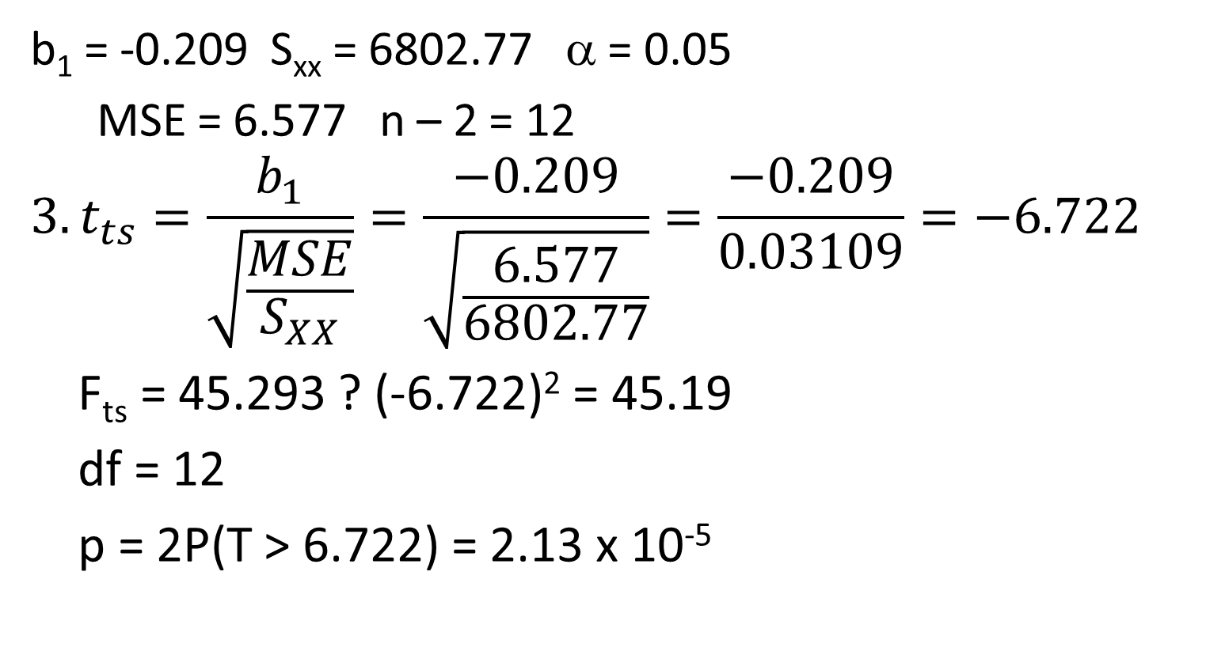
Example: SLR - HT
b₁ = -0.209 S_{xx} = 6802.77 α = 0.05
MSE = 6.577 n – 2 = 12
$$3. t_{ts}=\frac{b_{1}}{\sqrt{\frac{MSE}{S_{XX}}}}=\frac{−0.209}{\sqrt{\frac{6.577}{6802.77}}}=\frac{−0.209}{0.03109}=−6.722$$
F_{ts} = 45.293 ? (-6.722)² = 45.19
df = 12
p = 2P(T > 6.722) = 2.13 x 10⁻⁵
tts <- b1/SE
2*pt(6.722,12,lower.tail=FALSE)
Notes:
Step 3 is to calculate the test statistic. All we have to do is plug in the values for an answer of -6.722. [not in video: Assuming that b1 and SE have already defined, the code for this step is presented here.] [a]The F test statistic that we calculated earlier is 45.293. Notice how this numbers and the square of the t test statistic are the same to 1 decimal place. This difference is due to round off error. [a]The degrees of freedom is dfe which is 12. [a]The p-value is 2.13 time 10 to the -5. [not in video: the code is listed here.] Now should be removed: Previously, I stated that the p value for the F test was less than 0.0001. However, if you calculate it out to more decimal places, the value is identical to the t test statistic.

Slide 25
Example: SLR - HT
α = 0.05 p = 2.13 x 10⁻⁵
4. We reject H₀ because 2.13 x 10⁻⁵ < 0.05
The data does provide strong support
(p = 2.13 x 10⁻⁵) to the claim that there is a linear relationship between cetane number and iodine value.
Notes:
Step 4. We reject the null hypothesis because 2.13 times 10 to the -5 is less than 0.05.
[a]Therefore, the data does provide strong support (p = 2.13 x 10⁻⁵) to the claim that there is a linear relationship between cetane number and iodine value. Note that it does not matter which way that you state the variables here because you are claiming a linear relationship, but I try to be consistent when y versus x.

Slide 26
Cautions about Correlation and Regression:
Good experimental design.
Both describe linear relationship.
Both are affected by outliers.
Always PLOT the data.
Beware of extrapolation.
Beware of lurking variables
Correlation (association) does NOT imply causation!
Notes:
[not in video: Now that we have finished most of the basics of linear regression,] I would like to spend a couple of minutes about some cautions concerning the analysis of correlation and regression.
Just like with the rest of the inference methods, if you do not have a good experimental design, your data is meaningless.
Both correlation and linear regression do require a linear relationship. Do not forget this assumption!
Both the correlation and linear regression are affected by outliers.
To determine if your data is appropriate, you always need to plot the data.

Slide 27
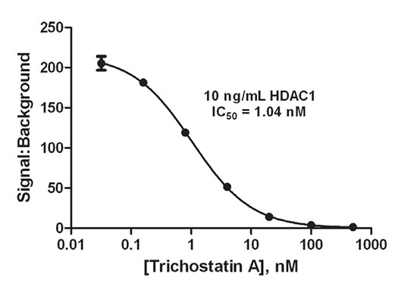
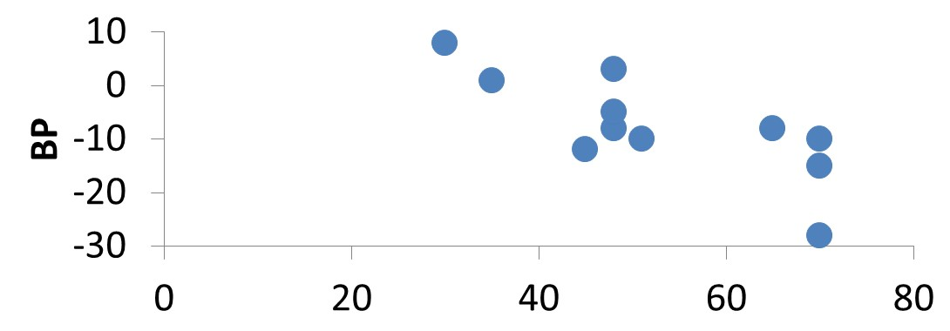
Cautions about Correlation and Regression:
Beware of extrapolation.
Notes:
Be ware of extrapolation. Extrapolation occurs when you are looking outside of the range of the explanatory variable, that is, where there are no points. Interpolation is within the range of the x-axis.
[a]The first example is my blood pressure versus medicine graph. Note that the range of the age starts around 24. This is because it is known that children react differently than adults to the same medicine even if you base the dose on mass of the person. Therefore, you can not use this data, to infer information concerning people that are younger than 24 years old.
[a]This is a dose response curve showing inhibition of HDAC1 enzyme activity by Trichostatin A. If you only had data in this range, you would think that the curve is linear over all concentrations. However, this is not true. Therefore, you would not be predicting the correct values outside of that range.

Slide 28
Cautions about Correlation and Regression:
Beware of lurking variables
Correlation (association) does NOT imply causation!
Notes:
I would like to add that if you have lurking variables, then you might not be measuring what you think you are. This is again saying that good experimental design is extremely important.
Finally, statistics provides you with association, it does not say anything about causation. Please be careful about this point. [not in video: This does not mean that there is no way to determine causation, it just means that you need additional information that is not from statistics to determine causation.]

Slide 29
12.3: Inferences Concerning the Mean Value and an Observed Value of Y for x = x* - Goals
Be able to calculate the confidence interval for the mean value of Y for x = x*.
Be able to calculate the confidence interval for the observed value of Y for x = x* (prediction interval)
Be able to differentiate these two confidence intervals from each other and the confidence interval of the slope.
Notes:
Section 12.3 Inferences Concerning the mean value and an observed value of Y for x = x star.
Remember that linear regression is used for two things: association and prediction. In the inference in Section 12.2, we discussed how to determine if X and Y are associated, now we are going to move on to prediction.
This book uses a star (*) to indicate the particular point that we are predicting at.
We will be discussing two different confidence intervals: 1) the mean at a particular point and 2) the observed value at a particular point. What is the difference between these two? The mean is the average of a number of responses taken when x = x star. The observed value is for the NEXT response taken when x = x star. You can see why in practice the observed value will be the more widely used choice. However, there are times when the average value is important also.
We will just be discussing the confidence intervals in class which is the more common application. The book also explains the hypothesis tests. Since the standard error is used in both of these methodologies, it is fairly easy to determine what the test statistic is for the hypothesis test without explicitly showing the methodology. If you are interested in these tests, please read the book.

Slide 30
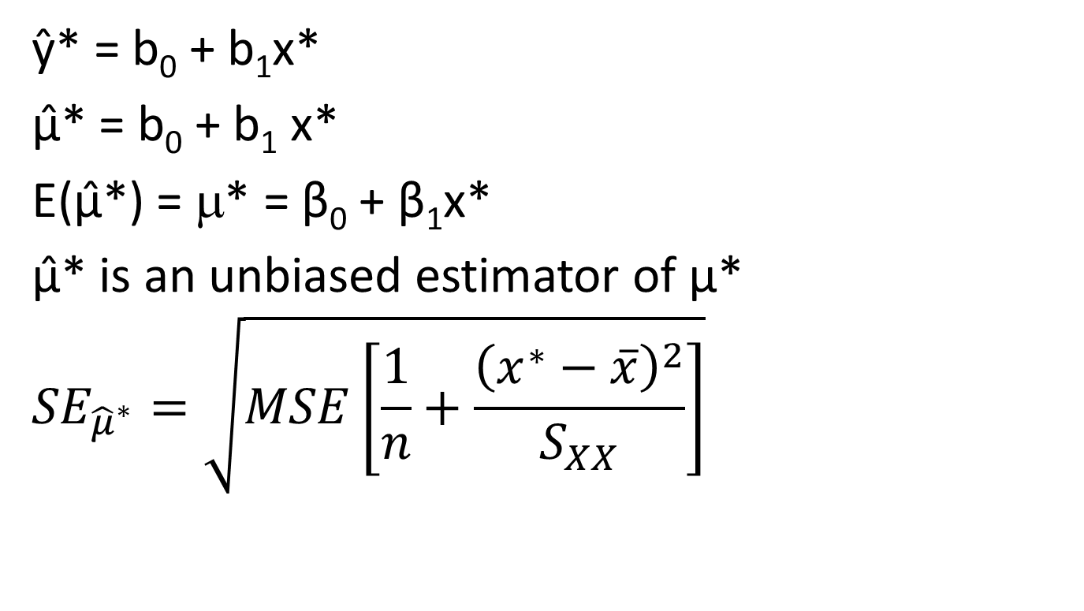
µ*
ŷ* = b₀ + b₁x*
µ̂* = b₀ + b₁ x*
E(μ̂*) = μ* = β₀ + β₁x*
μ̂* is an unbiased estimator of μ*
$${SE}_{{\hat{μ}}^{∗}}=\sqrt{MSE\left[\frac{1}{n}+\frac{{\left(x^{∗}−\overline{x}\right)}^{2}}{S_{XX}}\right]}$$
Notes:
The book does not give a symbol for the confidence interval of the mean at a specific value, but I am going to indicate this by mu star. [a]We already know how to predict the value of the line at a particular x value, we just plug in the value of x* and calculate the y* value. However, this does not take into account the error of the response variable. Therefore, we really need to have a confidence interval for each y*. [a]That is we, need to find the confidence interval around mu hat * = b0 + b1 x*. Remember that the estimated value is indicated by a hat (^). [a] So the expected value of mu hat * is the actual value which is beta 0 + beta 1 x*.
[a]This value of mu hat * is an unbiased estimator of mu*. We will assume as before that the residuals are normal which means that mu star is also normal. Therefore, if we know standard error of mu hat *, we will be able to generate the confidence interval. I am not going to derive this term (neither does the book), however, if you are interested, please contact your instructor. [a]The standard error is shown here.
Again this is a t distribution with degrees of freedom of dfe = n – 2 because the only thing in the term that is random is MSE.
The variance consists only of two parts, one part from the slope and one part from the y-intercept with no error coming from the original error of each point.
The 1/n term is from the intercept and the other term comes from the slope of the line.

Slide 31
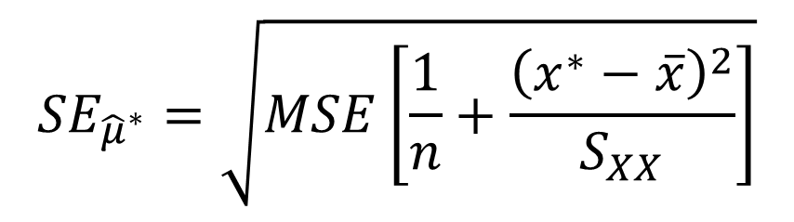
SE_{µ̂*}
$${SE}_{{\hat{μ}}^{∗}}=\sqrt{MSE\left[\frac{1}{n}+\frac{{\left(x^{∗}−\overline{x}\right)}^{2}}{S_{XX}}\right]}$$
Notes:
Notice how the part of the variance that comes from the slope depends on the value of x*. [a]This means that the variance will increase if x* is further from the mean value of x.

Slide 32
SE_{µ̂*}
$${SE}_{{\hat{μ}}^{∗}}=\sqrt{MSE\left[\frac{1}{n}+\frac{{\left(x^{∗}−\overline{x}\right)}^{2}}{S_{XX}}\right]}$$
newdata <- data.frame(XVar = NewValue)
predict(Table.lm, newdata,
interval = "confidence", level = 0.99)
SE <- sqrt(MSE*(1/n + (xstar – xbar)^2/Sxx))
Notes:
The code to perform these calculations is described in more detail in the tutorial for Computer Assignment 9c if you know the data. First we have to create a new table which just consists of the value of x*. Then we use the function predict() where the interval is "confidence" to generate the actual interval.
[a]If you don't have the data, you code in the value for SE explicitly as shown here. In this code, we are assuming that you know all of the variables. Then you calculate the confidence interval as before.
Now that you have the standard error, you can also perform the significance tests. If you are interested, please read the book.

Slide 33
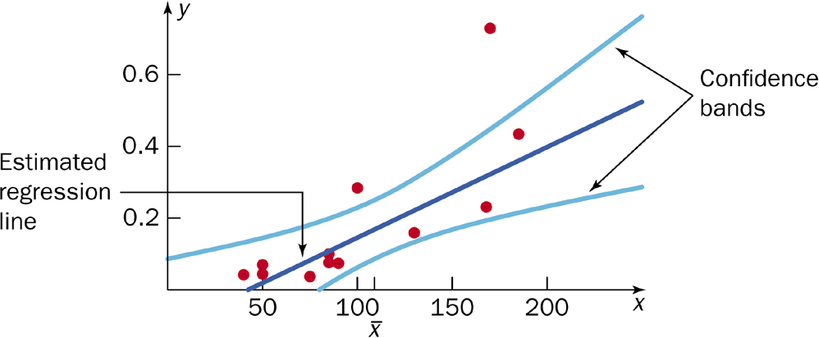
Confidence Bands
Notes:
When you do the calculations for all of the points on the line, the resulting curves are called confidence bands. Notice that the shape of both of the confidence bands is elliptical. This is because we have the x star – x bar term in the variance.
These confidence bands are more complicated to calculate because we have another multiple comparison problem. This derivation is covered in STAT 512.
I will cover more about the interpretation of the confidence bands at the end of this section.
An optional example follows.

Slide 34
Example: LR – μ̂*
The cetane number is a critical property in specifying the ignition quality of a fuel used in a diesel engine. Determination of this number for a biodiesel fuel is expensive and time-consuming. Therefore a way of predicting this number is wanted. The data on the next slide is x = iodine value (g) and y = cetane number for a sample of 14 biofuels. The iodine value is the amount of iodine necessary to saturate a sample of 100g of oil.
What is the 95% confidence interval for the cetane number with am iodine value of 100.
y₁₀₀* = μ̂₁₀₀ = 54.313 n = 14
Notes:
Example Optional Confidence interval for the mean at x*.
This is the same cetane example as before. i) What is the 95% confidence interval for the cetane number with an iodine value of 100. Remember for this question, you need to be given the value at which you will be calculating the confidence interval.
[a]We have previously calculated the predicted value when the cetane number is 100. Again, n is 14. Because of the complicated formula for the standard error, you will either be given the standard error directly (like in this example) or you will calculate the interval from the data (Computer Assignment 9c).

Slide 35
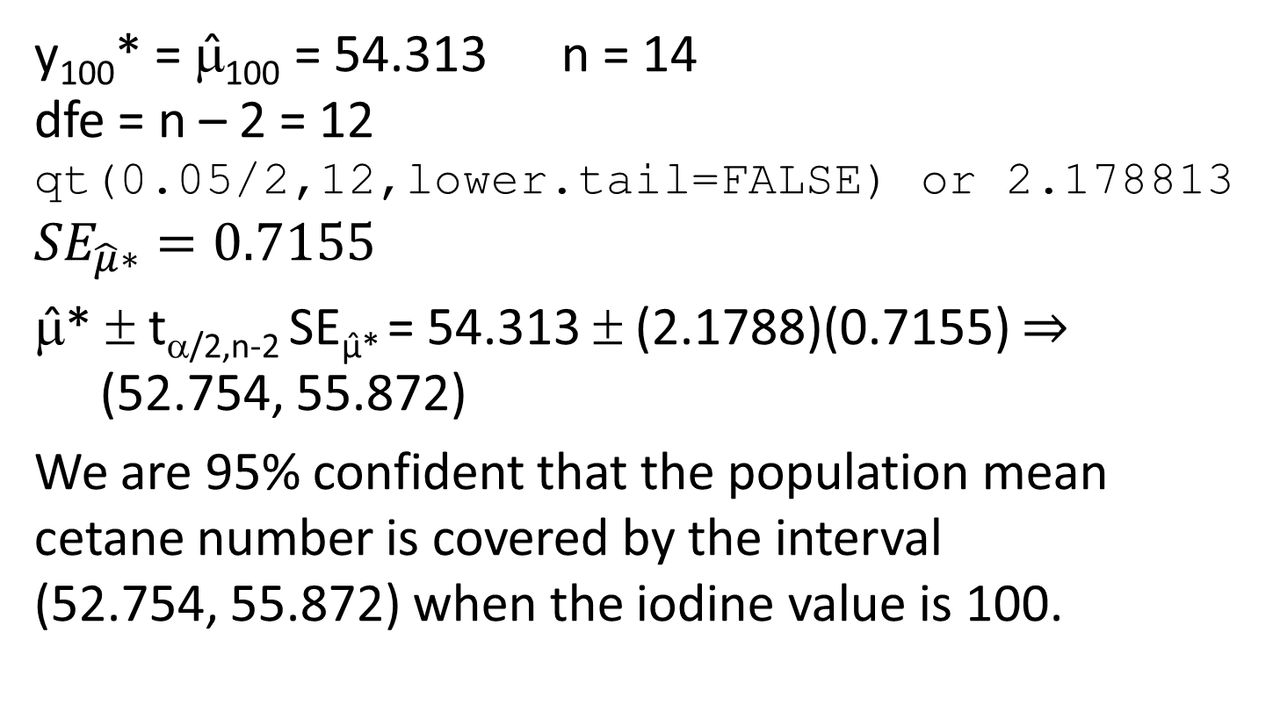
Example: LR – μ̂*
y₁₀₀* = μ̂₁₀₀ = 54.313 n = 14
dfe = n – 2 = 12
qt(0.05/2,12,lower.tail=FALSE) or 2.178813
$${SE}_{\hat{μ}∗}=0.7155$$
μ̂* ± t_{α/2,n-2} SE_{µ̂*} = 54.313 ± (2.1788)(0.7155) $⇒$ (52.754, 55.872)
We are 95% confident that the population mean cetane number is covered by the interval (52.754, 55.872) when the iodine value is 100.
Notes:
This is a 95% confidence interval with degrees of freedom n – 2 = 12. [a]Therefore the critical value is 2.1788 which is the same as before.
[a]Using R to calculate the standard error for our estimator, we obtain a value of 0.7155.
[a]The equation to calculate the interval is shown here. [a]Either using R to calculate the value or plugging in the values, we get an interval of 52.754 to 55.872.
Remember that this is the confidence interval at an iodine value of 100 and no other point.
[a]Therefore, we are 95% confident that the population mean cetane number is covered by the interval (52.754, 55.872) when the iodine value is 100. You always have to mention the point at which this was calculated in the interpretation.

Slide 36
Ŷ*
Y* = β₀ + β₁X* + ε
E(Ŷ*) = β₀ + β₁X*
Var(Ŷ*) = Var(β₀ + β₁X* + ε)
= Var(the mean) + Var(ε)
Notes:
Usually we are not interested in knowing what the confidence interval is around the mean of y* at x*. We want to know what the confidence interval will be for the next time that x* occurs. For example, we are not really interested in what the average cetane number is when the iodine value is 100. We want to know what the cetane number is the next time we measure an iodine value of 100. If we are using the homework grade to predict the exam score, you are interested in what possible values you will get, not the range of values for the average of all students with that homework score.
Since we are predicting the next point, we call this a prediction interval. To differentiate this from the last type of confidence interval which was mu * or the average value at x*, I will use a y hat * or the predicted value of y hat at x*. Again, the book does not use a symbol to indicate this type of interval.
Conceptually, what is the difference between y hat star and mu star?
With mu star, we were estimating a mean. With y hat star, we are estimating an individual point. Therefore, you would expect the range of y hat star to be greater than the range of mu star.
What is the difference between these two intervals? [a]The model is now y * = beta 0 plus beta 1 x star plus epsilon. We have added an epsilon to the previous model because we are discussing the individual points, not an average. [a]The expected value of y hat star is the same because the expected value of epsilon is 0.
[a]The variance is now different because epsilon has a variance of sigma squared. Therefore, the variance of y hat * will always be bigger than the variance of mu star that we estimated before. In addition, the variance should include one more sigma squared which is estimated by MSE.

Slide 37
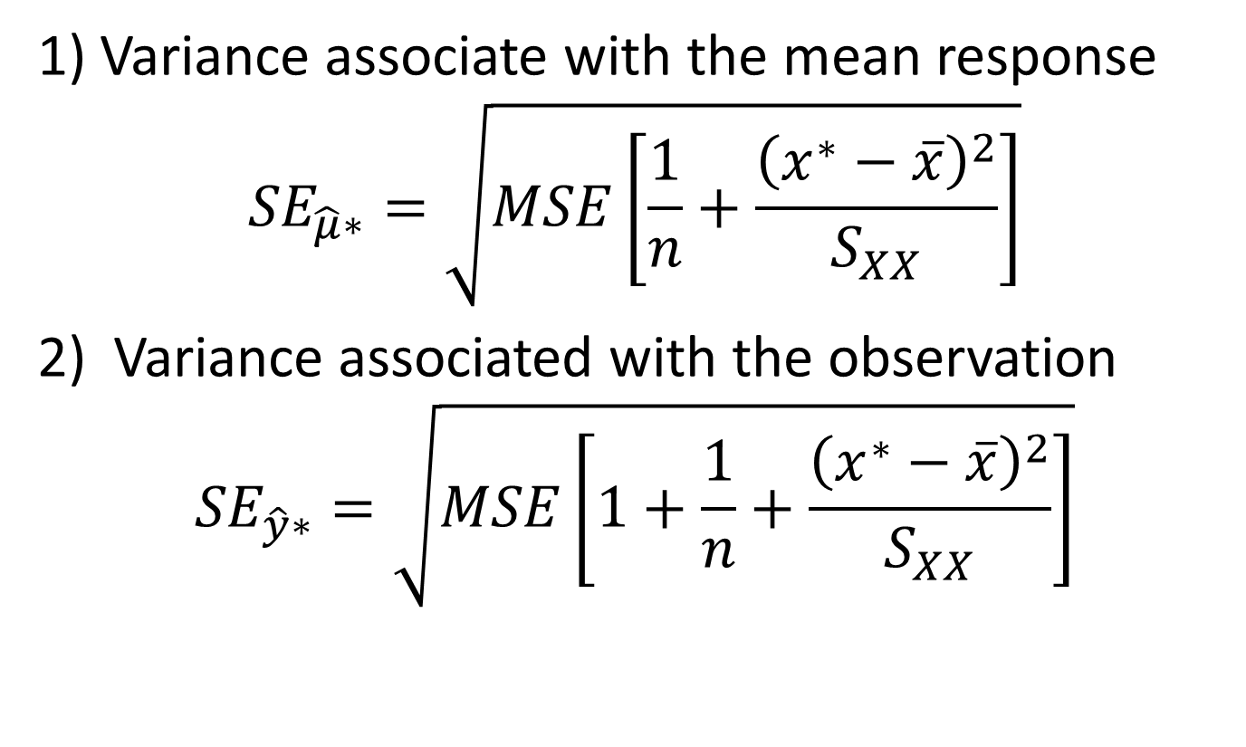
SE_{ŷ}
1) Variance associate with the mean response
$${SE}_{\hat{μ}∗}=\sqrt{MSE\left[\frac{1}{n}+\frac{{\left(x^{∗}−\overline{x}\right)}^{2}}{S_{XX}}\right]}$$
Variance associated with the observation
$${SE}_{\hat{y}∗}=\sqrt{MSE\left[1+\frac{1}{n}+\frac{{\left(x^{∗}−\overline{x}\right)}^{2}}{S_{XX}}\right]}$$
Notes:
The standard errors for both mu star and y hat star are shown here. You can see that there is an additional ‘1’ in the term associated with the variance for the individual observation just like we stated in the last slide.
Again we have the x* minus x bar term so the variance depends on how far the observation is from the mean value. In addition, the range of the prediction interval will always be greater than the range for the interval for the mean at a point. The difference in size depends on the value of MSE. This makes sense because MSE is the estimated value for variance of the points from the line.

Slide 38


R code
If the data is available:
$${SE}_{{\hat{μ}}^{∗}}$$
newdata <- data.frame(XVar = NewValue)
predict(Table.lm, newdata,
interval = "confidence", level = 0.99)
$${SE}_{\hat{y}∗}$$
newdata <- data.frame(XVar = NewValue)
predict(Table.lm, newdata,
interval = "prediction", level = 0.99)
Notes:
The code for both the standard error for the mean at a point and the prediction interval are shown here if the data is available. You can see that the only difference is to change the word 'confidence' to 'prediction'. For more information on the output, please see Computer Assignment 9c.

Slide 39
R code
If the data is not available:
$${SE}_{{\hat{μ}}^{∗}}$$
SE <- sqrt(MSE*(1/n
+ (xstar – xbar)^2/Sxx))
$${SE}_{\hat{y}∗}$$
SE <- sqrt(MSE*(1 + 1/n
+ (xstar – xbar)^2/Sxx))
Notes:
If the data is not available, the different code is shown here. You can see that the only difference is the added '1'.

Slide 40
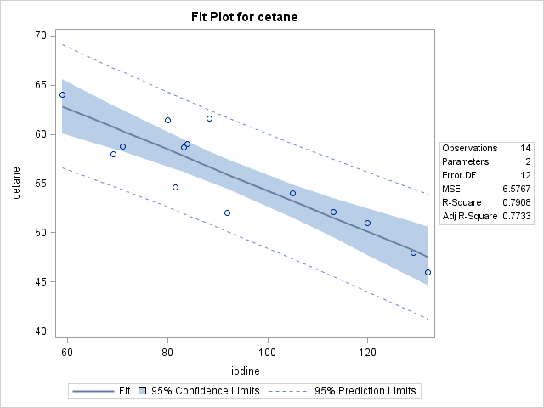
Confidence/Prediction Band
Notes:
Just like with confidence bands, you can calculate the prediction interval at all possible points. This is called a prediction band. Again the limits of the bands are elliptical for the same reason as for the confidence bands and they are harder to calculate because of the multiple confidence intervals.
[a]I would like to show you the example of both of the bands for the optional cetane example so that you get a better feel of what is happening. This is SAS output where the confidence band is shaded and the prediction band is indicated by the dotted lines. You can see that both of these bands are elliptical though it is harder to see this in the prediction band because it is wider.
The confidence band tells us the confidence of the equation of the line. Therefore, the actual data points are not necessarily included in the shaded area. However, the prediction band is telling you about what the next value will be. All or most of the data points will be included in this area.
An optional example follows.

Slide 41
Example: LR - ŷ*
The cetane number is a critical property in specifying the ignition quality of a fuel used in a diesel engine. Determination of this number for a biodiesel fuel is expensive and time-consuming. Therefore a way of predicting this number is wanted. The data on the next slide is x = iodine value (g) and y = cetane number for a sample of 14 biofuels. The iodine value is the amount of iodine necessary to saturate a sample of 100g of oil.
Predict the cetane number for the next sample of biofuel that contains an iodine value of 100 to a 95% confidence. (Find the 95% prediction interval with an iodine value of 100.)
Notes:
Example Optional Prediction interval
This time we are going to calculate the 95% prediction interval. I have stated the question in two ways, either of which might be used on the homework or the exam.
j) Predict the cetane number for the next sample of biofuel that contains an iodine value of 100 to a 95% confidence.
or
Find the 95% prediction interval with an iodine value of 100.

Slide 42
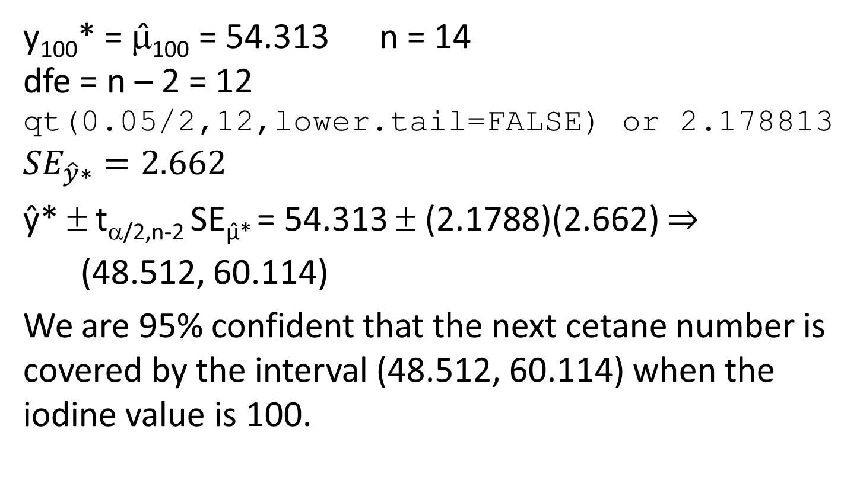
Example: LR - ŷ*
y₁₀₀* = μ̂₁₀₀ = 54.313 n = 14
dfe = n – 2 = 12
qt(0.05/2,12,lower.tail=FALSE) or 2.178813
$${SE}_{\hat{y}∗}=2.662$$
ŷ* ± t_{α/2,n-2} SE_{µ̂*} = 54.313 ± (2.1788)(2.662) $⇒$
(48.512, 60.114)
We are 95% confident that the next cetane number is covered by the interval (48.512, 60.114) when the iodine value is 100.
Notes:
Again, we have the same y*, n, and critical value.
[a]The standard error is different because of the added ‘1’. The value is now 2.662.
[a]I changed the symbol for the estimator even though y hat * and mu hat are the same. The interval is now 48.512 to 60.114.
[a]We now state the interpretation a little differently. We are 95% confident that the next cetane number is covered by the interval (48.512, 60.114) when the iodine value is 100. Notice how we do not save average, but change that to the ‘next cetane number.’

Slide 43
Example: LR - ŷ*
Mean response: (52.754, 55.872)
Prediction interval: (48.512. 60.114)
Notes:
Let’s compare the two values at an iodine value of 100. You can see that the range of the mean response is smaller than the range of the prediction interval. This is because the prediction interval has the added uncertainty of the point which is sigma squared.

Slide 44
12.5: Multiple Linear Regression - Goals
Be able to state when multiple linear regression should be used.
Given a model, be able to determine if the situation can be analyzed by multiple linear regression.
Using computer output, be able to write down the regression line.
Given the regression line and the values for all of the explanatory variables, be able to predict the response variable.
Be able to write down the ANOVA table.
Be able to perform the hypothesis test to test for a significant multiple linear regression.
Given the appropriate computer output, be able to determine if the response variable is dependent on any of the explanatory variables (hypothesis test)
Notes:
Section 12.5: Multiple Linear Regression
Multiple linear regression is when we have more than one explanatory variable. In this section we will only briefly cover the importance, the determination of the regression line, and inference. You will be given computer output for all of the calculations, except for the ANOVA table where you will be given the summations just like in Chapter 11. STAT 512 covers multiple linear regression in much more detail.
Simple linear regression is very useful. However, there are a number of real-life situations where we need to extend the model further. What happens if there is more than one explanatory variable that is important? For example, the yield on a 30-year treasury bond might be predicted by the prime rate, the unemployment rate, the Consumer Price Index, retail sales and the M1 money supply. We will be providing some other examples as we go through this section. In addition, if the relationship between X and Y is a polynomial, you can use multiple linear regression as an appropriate model.

Slide 45
Multiple Linear Regression Model
Y_{i} = β₀ + β₁x_{1i} + . . . + β_{k}x_{ki} + ε_{i}
where ε_{i} ~ N(0, σ²)
E(Y_{i}) = β₀ + β₁x_{1i} + . . . + β_{k}x_{ki}
Var(Y_{i}) = σ²
iid
Notes:
Y is again the response variable, but this time there are k different explanatory variables from x₁ to x_{k}. The data point is again indicated by an i. As before the epsilon’s sub i are iid normal with mean 0 and variance sigma squared. [a]The expected value is beta 0 + beta 1 x1 up to beta k x k. [a] The variance of the response variable is constant and is sigma squared.

Slide 46
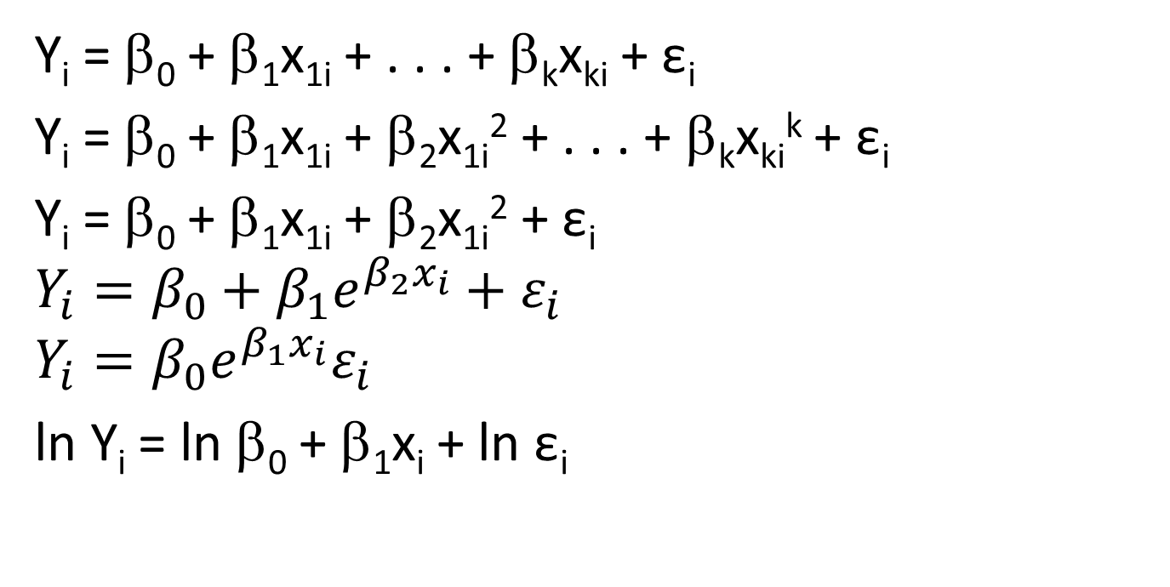
Multiple LINEAR Regression
Y_{i} = β₀ + β₁x_{1i} + . . . + β_{k}x_{ki} + ε_{i}
Y_{i} = β₀ + β₁x_{1i} + β₂x_{1i}² + . . . + β_{k}x_{ki}^{k} + ε_{i}
Y_{i} = β₀ + β₁x_{1i} + β₂x_{1i}² + ε_{i}
$$Y_{i}=β_{0}+β_{1}e^{β_{2}x_{i}}+ε_{i}$$
$$Y_{i}=β_{0}e^{β_{1}x_{i}}ε_{i}$$
ln Y_{i} = ln β₀ + β₁x_{i} + ln ε_{i}
Notes:
Why is this called linear regression? The expression is linear in the unknown parameters, the beta sub i’s. This does not mean that the explanatory variables can not have exponents.
What is the meaning of each of the beta i’s? This is the average change when x sub i is increased by 1 unit assuming that all of the rest of the explanatory variables are held constant.
[a]A special case of multiple linear regression is the polynomial regression shown. If your scatterplot indicated that the situation was a parabola, [a]you would stop at the squared term in your analysis. This is still linear even though the explanatory terms are not linear. This is because the parameters are linear.
So what would be an example of a situation that was not linear? [a]In this case, we have an exponential function of the parameters. If there was no beta 2 in the exponent then this would be a simple linear regression with a transformed explanatory variable.
[a]If you remove the sums, you can take the natural log of both sides to get [a] this equation which is linear with a transformed y. Since the parameters and error are unknown constants, it does not matter if there is a log in front of them or not.

Slide 47
Assumptions for Multiple Linear Regression
SRS (k+1-tuples) with the observations independent of each other.
(x_{1i}, x_{2i}, …, x_{ki}, y_{i})
The relationship is linear (k+1 dimensional) in the population.
The residuals are normally distribution around the population regression line.
The standard deviation of the response is constant.
Notes:
The assumptions for multiple linear regression are the very similar to the assumptions for simple linear regression.
In this case, we don’t have pairs of observations, but k+1-tuples of observations. [a]An example of a k+1 tuple is shown here.

Slide 48
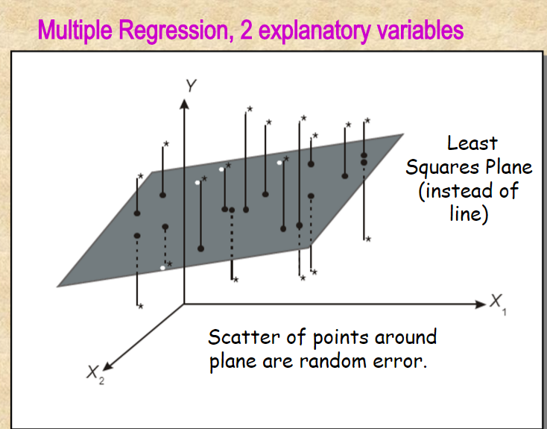
The relationship is linear (k+1 dimensional) in the population.
Notes:
We are also assuming that the relationship is linear between all of the explanatory variables and the response variable. This is very hard to graph since this is a k+1 dimensional graph.
[a]This is shown graphically here for 2 explanatory variables. Now the ‘line’ is 2-dimensional or a plane.

Slide 49
Assumptions for Linear Regression
SRS (k+1-tuples) with the observations independent of each other.
(x_{1i}, x_{2i}, …, x_{ki}, y_{i})
The relationship is linear (k+1 dimensional) in the population.
The residuals are normally distribution around the population regression line.
The standard deviation of the response is constant.
Notes:
The other two assumptions are the same as before. Except to see them graphically, you would have to plot the residuals vs each of the explanatory variables.
An optional example follows.

Slide 50
Example: MLR - Equation
It is important to know how long a tool will last (min) in the industrial setting. The cutting tool in this study is used to cut a particular type and size of cold-rolled steel. The predictors of interest are x₁ = cutting speed (feet/min), x₂ = feed rate (in/revolution) and x₃ = depth of cut (in).
Notes:
Example Optional Multiple Linear regression – equation of the line
The data for this example is on Blackboard under the file name of ch.11.4_example.txt. The software package that I am using is SAS [not in video: R]. The code that I used is listed in the PowerPoint Slides but will not be on the Videos. [The code is not listed because it is bonus in Computer Assignment 9c.] If you are interested in how to do the calculations in R, please contact your instructor. [should be removed.]
It is important to know how long a tool will last in min in the industrial setting. The cutting tool in this study is used to cut a particular type and size of cold-rolled steel. The predictors of interest are x₁ = cutting speed in feet/min, x₂ = feed rate in inches/revolution and x₃ = depth of cut in inches. I have indicated in red what the names of the variables are in the SAS [not in video:R] code.

Slide 51
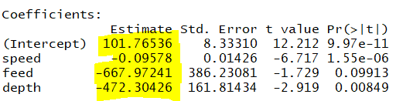
Example: MLR - Equation
a) What is the equation of the line?
ŷ = 101.765 – 0.0958 x₁ – 667.972 x₂ - 472.304 x₃
ŷ = 101.765 – 0.0958 speed – 667.972 feed - 472.304 depth
Notes:
a) What is the equation of the line.
[a]The output is shown here. The intercept is the y intercept, then the estimated parameters for the explanatory variables are indicated by name of the variables.
[a]The equation is ŷ = 101.765 – 0.0958 x₁ – 667.972 x₂ - 472.304 x₃. Sometimes, it is confusing with multiple variables to use the symbols, [a]so I also like to write out the equation of the line with the names of the variables as shown here.

Slide 52
Example: MLR - Equation
ŷ = 101.765 – 0.0958 speed – 667.972 feed - 472.304 depth
b) What is the mean life of a tool that is being used to cut depths of 0.03 inch at a speed rate of 450 feet/min with a feed rate of 0.01 in/revolution?
ŷ = 101.765 – (0.0958)(450) – (667.972)(0.01) – (472.304)(0.03) = 37.806
Notes:
b) What is the mean life of a tool that is being used to cut depths of 0.03 inch at a speed rate of 450 feet/min with a feed rate of 0.01 in/revolution?
[a]To answer this question, we just plug in the values in to the equation to obtain an answer of 37.806. You can see why I like to include the variable names in the equation instead of x sub i’s.

Slide 53
Example: MLR - Equation
c) What is the interpretation of β₁ = -0.0958? Of β₂ = -667.972? Of β₃ = -472.304?
β₁ = the mean slope of tool life vs cutting speed assuming that the feed rate and depth of cut are constant.
β₂ = the mean slope of tool life vs feed rate assuming that the cutting speed and depth of cut are constant.
β₃ = the means slope of tool life vs depth of cut assuming that the cutting speed and feed rate are constant.
Notes:
c) What is the interpretation of β₁ = -0.0958? Of β₂ = -667.972? Of β₃ = -472.304?
[a]β₁ is the average change in tool life associated with a 1 foot/min increase in cutting speed assuming that feed rate and depth of cut are constant
[a]β₂ is the average change in tool life associated with a 1 in/revolution increase in feed rate assuming that cutting speed and depth of cut are constant
[a]β₃ is the average change in tool life associated with a 1 in increase in depth of cut assuming that cutting speed and feed rate are constant

Slide 54
ANOVA table for MLR
Source | df | SS | MS | F
Regression | k
Error
Total
dfr = k + 1 – 1 = k
Notes:
The ANOVA table for multiple regression is similar to the table for simple linear regression. However this time, I will not be providing you with the formulas for the sum of squares. At least two of them will always be provided.
The degrees of freedom for the regression is still the number of parameters minus 1. [a]However, there [not in video: are] k + 1 parameters, therefore, dfr = k + 1 – 1 or k.
[a]The degrees of freedom for the total is dft = n – 1.
[a]The degrees of freedom for dfe is then dft – dfr = n – 1 – k.
[a]The rest of the table is calculated as before. [not in video: This can also be calculated from R code but it is more complicated. We will not be going into more details in this course.]
[a]the estimate of the variances is again MSE [a] and the coefficient of determination, r squared is SSR/SST.
An optional example is next.

Slide 55
ANOVA table for MLR
Source | df | SS | MS | F
Regression | k
Error
Total | n - 1
dft = n – 1
Notes:
The ANOVA table for multiple regression is similar to the table for simple linear regression. However this time, I will not be providing you with the formulas for the sum of squares. At least two of them will always be provided.
The degrees of freedom for the regression is still the number of parameters minus 1. [a]However, there [not in video: are] k + 1 parameters, therefore, dfr = k + 1 – 1 or k.
[a]The degrees of freedom for the total is dft = n – 1.
[a]The degrees of freedom for dfe is then dft – dfr = n – 1 – k.
[a]The rest of the table is calculated as before. [not in video: This can also be calculated from R code but it is more complicated. We will not be going into more details in this course.]
[a]the estimate of the variances is again MSE [a] and the coefficient of determination, r squared is SSR/SST.
An optional example is next.

Slide 56
ANOVA table for MLR
Source | df | SS | MS | F
Regression | k
Error | n – k – 1
Total | n - 1
dfe = dft – dfr = n – 1 – k
Notes:
The ANOVA table for multiple regression is similar to the table for simple linear regression. However this time, I will not be providing you with the formulas for the sum of squares. At least two of them will always be provided.
The degrees of freedom for the regression is still the number of parameters minus 1. [a]However, there [not in video: are] k + 1 parameters, therefore, dfr = k + 1 – 1 or k.
[a]The degrees of freedom for the total is dft = n – 1.
[a]The degrees of freedom for dfe is then dft – dfr = n – 1 – k.
[a]The rest of the table is calculated as before. [not in video: This can also be calculated from R code but it is more complicated. We will not be going into more details in this course.]
[a]the estimate of the variances is again MSE [a] and the coefficient of determination, r squared is SSR/SST.
An optional example is next.

Slide 57
ANOVA table for MLR
Source | df | SS | MS | F
Regression | k | SSR (from data)
Error | n – k – 1 | SSE (from data)
Total | n – 1 | SST (from data)
summary(aov(LinearRegressionResultTable))
Notes:
The ANOVA table for multiple regression is similar to the table for simple linear regression. However this time, I will not be providing you with the formulas for the sum of squares. At least two of them will always be provided.
The degrees of freedom for the regression is still the number of parameters minus 1. [a]However, there [not in video: are] k + 1 parameters, therefore, dfr = k + 1 – 1 or k.
[a]The degrees of freedom for the total is dft = n – 1.
[a]The degrees of freedom for dfe is then dft – dfr = n – 1 – k.
[a]The rest of the table is calculated as before. [not in video: This can also be calculated from R code but it is more complicated. We will not be going into more details in this course.]
[a]the estimate of the variances is again MSE [a] and the coefficient of determination, r squared is SSR/SST.
An optional example is next.

Slide 58
ANOVA table for MLR
Source | df | SS | MS | F
Regression | k | SSR (from data)
Error | n – k – 1 | SSE (from data)
Total | n – 1 | SST (from data)
s² = MSE
Notes:
The ANOVA table for multiple regression is similar to the table for simple linear regression. However this time, I will not be providing you with the formulas for the sum of squares. At least two of them will always be provided.
The degrees of freedom for the regression is still the number of parameters minus 1. [a]However, there [not in video: are] k + 1 parameters, therefore, dfr = k + 1 – 1 or k.
[a]The degrees of freedom for the total is dft = n – 1.
[a]The degrees of freedom for dfe is then dft – dfr = n – 1 – k.
[a]The rest of the table is calculated as before. [not in video: This can also be calculated from R code but it is more complicated. We will not be going into more details in this course.]
[a]the estimate of the variances is again MSE [a] and the coefficient of determination, r squared is SSR/SST.
An optional example is next.

Slide 59
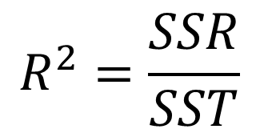
ANOVA table for MLR
Source | df | SS | MS | F
Regression | k | SSR (from data)
Error | n – k – 1 | SSE (from data)
Total | n – 1 | SST (from data)
$$R^{2}=\frac{SSR}{SST}$$
Notes:
The ANOVA table for multiple regression is similar to the table for simple linear regression. However this time, I will not be providing you with the formulas for the sum of squares. At least two of them will always be provided.
The degrees of freedom for the regression is still the number of parameters minus 1. [a]However, there [not in video: are] k + 1 parameters, therefore, dfr = k + 1 – 1 or k.
[a]The degrees of freedom for the total is dft = n – 1.
[a]The degrees of freedom for dfe is then dft – dfr = n – 1 – k.
[a]The rest of the table is calculated as before. [not in video: This can also be calculated from R code but it is more complicated. We will not be going into more details in this course.]
[a]the estimate of the variances is again MSE [a] and the coefficient of determination, r squared is SSR/SST.
An optional example is next.

Slide 60
Example: MLR – ANOVA table
It is important to know how long a tool will last (min) in the industrial setting. The cutting tool in this study is used to cut a particular type and size of cold-rolled steel. The predictors of interest are x₁ = cutting speed (feet/min), x₂ = feed rate (in/revolution) and x₃ = depth of cut (in).
d) What is the ANOVA table for this situation?
dfr = k = 3 n = 24 dft = n – 1 = 24 – 1 = 23
dfe = n – k – 1 = 24 – 3 – 1 = 20
Notes:
Example Optional Multiple Linear regression – ANOVA table
This is the same example as before. d) What is the ANOVA table for this situation?
[a]dfr is the number of explanatory variables, k, which is 3. [a]Since there are 24 data points, [a]we have dft = n – 1 = 23 and [a]dfe = n – k – 1 = 20.

Slide 61
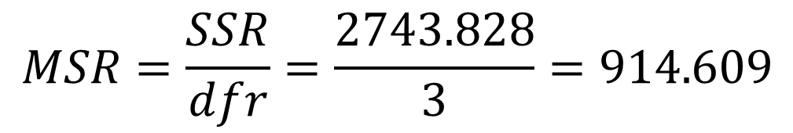
Example: MLR – ANOVA
Analysis of Variance
Source | DF | Sum of Squares | Mean Square | F Value
Regression | 3 | 2743.828 | 914.609
Error | 20 | 874.130
Corrected Total | 23 | 3617.958
$$MSR=\frac{SSR}{dfr}=\frac{2743.828}{3}=914.609$$
Notes:
I have already filled in the degrees of freedom and the sum of squares.
[a]MSR = SSR/dfr = 2743.828/3 = 914.609
[a]MSE = SSE/dfe = 874.13/20 = 43.707
[a]F = MSR/MSE = 914.609/43.707 = 20.93

Slide 62
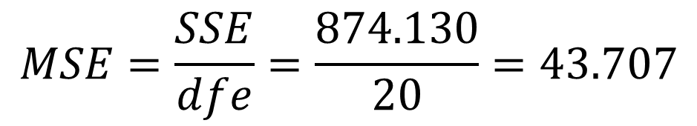
Example: MLR – ANOVA
Analysis of Variance
Source | DF | Sum of Squares | Mean Square | F Value
Regression | 3 | 2743.828 | 914.609
Error | 20 | 874.130 | 43.707
Corrected Total | 23 | 3617.958
$$MSE=\frac{SSE}{dfe}=\frac{874.130}{20}=43.707$$
Notes:
I have already filled in the degrees of freedom and the sum of squares.
[a]MSR = SSR/dfr = 2743.828/3 = 914.609
[a]MSE = SSE/dfe = 874.13/20 = 43.707
[a]F = MSR/MSE = 914.609/43.707 = 20.93

Slide 63
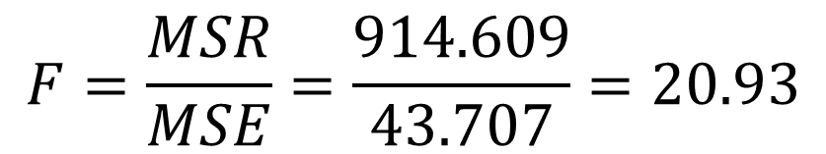
Example: MLR – ANOVA
Analysis of Variance
Source | DF | Sum of Squares | Mean Square | F Value
Regression | 3 | 2743.828 | 914.609 | 20.93
Error | 20 | 874.130 | 43.707
Corrected Total | 23 | 3617.958
$$F=\frac{MSR}{MSE}=\frac{914.609}{43.707}=20.93$$
Notes:
I have already filled in the degrees of freedom and the sum of squares.
[a]MSR = SSR/dfr = 2743.828/3 = 914.609
[a]MSE = SSE/dfe = 874.13/20 = 43.707
[a]F = MSR/MSE = 914.609/43.707 = 20.93

Slide 64
Example: MLR – ANOVA
e) What is the estimate of the variance?
Analysis of Variance
Source | DF | Sum of Squares | Mean Square | F Value
Regression | 3 | 2743.828 | 914.609 | 20.93
Error | 20 | 874.130 | 43.707
Corrected Total | 23 | 3617.958
MSE = 43.707
Notes:
e) What is the estimate of the variance?
[a]MSE = 43.707

Slide 65
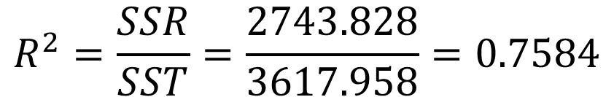
Example: MLR – ANOVA
f) What is the total variation of how long the tool will last that is due to the speed, feed, and depth?
Analysis of Variance
Source | DF | Sum of Squares | Mean Square | F Value
Regression | 3 | 2743.828 | 914.609 | 20.93
Error | 20 | 874.130 | 43.707
Corrected Total | 23 | 3617.958
$$R^{2}=\frac{SSR}{SST}=\frac{2743.828}{3617.958}=0.7584$$
Notes:
f) What is the total variation of how long the tool will last that is due to the speed, feed, and depth?
This is the coefficient of determination.
[a] R squared = SSR/SST = 0.7584

Slide 66
Inference
Association
slope of each of the explanatory variables
Notes:
We again are going to be covering two types of inference. The first type is the association of all of the variables. We will see that this is the F test. This will tell us if any of the explanatory variables have a linear association with the response variable. If any of them are linearly associated, we need to perform a t test on each slope to see which ones are linearly associated. Again, there are complications in this methodology which we do not have time to cover in this class.

Slide 67

LR Hypothesis Test: Summary
H₀: β₁ = β₂ = … = β_{k} = 0
H_{a}: At least one β_{i} ≠ 0
Test statistic: F_{ts} $=\frac{MSR}{MSE}$
p-value: p = P(F > F_{ts})
Notes:
This time our null hypothesis is that none of the explanatory variables have a linear relationship. This means that all of their slopes are equal to 0. This is different than in ANOVA where we stated that all of the means were equal. The alternative hypothesis is that at least one of the slopes is not 0. This means that at least one of the variables has a linear association with the response variable. Remember in ANOVA, we had to use an F test when there were more than two populations. This means that there are more than two variables. Since a line has two variables, if we have more than one explanatory variable, we then have more than two variables, so we have to use an F test. Again, the test statistic is MSR over MSE with the p value calculated as before.

Slide 68
ANOVA table for MLR
Source | df | SS | MS | F
Regression | k | SSR (from data)
Error | n – k – 1 | SSE (from data)
Total | n – 1 | SST (from data)
Notes:
But now the numerator degree of freedom is k and the denominator degree of freedom is n – k – 1.

Slide 69
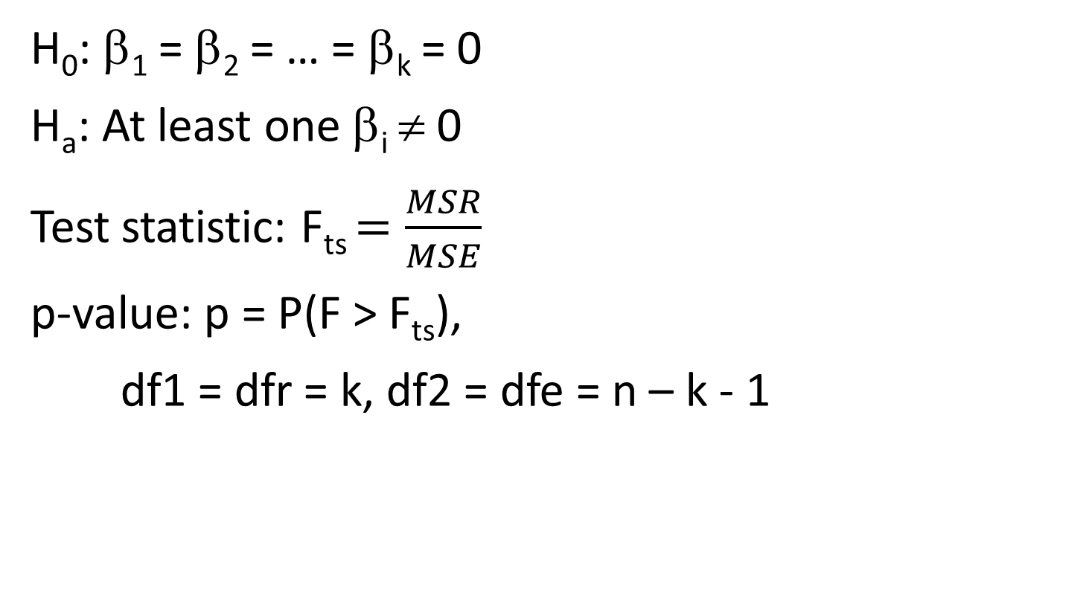
LR Hypothesis Test: Summary
H₀: β₁ = β₂ = … = β_{k} = 0
H_{a}: At least one β_{i} ≠ 0
Test statistic: F_{ts} $=\frac{MSR}{MSE}$
p-value: p = P(F > F_{ts}),
df1 = dfr = k, df2 = dfe = n – k - 1
Notes:
Therefore, you need the following degrees of freedom to calculate the p-value. On the homework, you will calculate the p-value using computer software (or the internet) [not in video: using R. I have note repeated the code because it is the same as before.]. On the exam, if required, the p-value will be given to you.
Remember when asked to do a hypothesis test to perform the four steps.
An optional example follows.

Slide 70
Example: MLR – Association
It is important to know how long a tool will last (min) in the industrial setting. The cutting tool in this study is used to cut a particular type and size of cold-rolled steel. The predictors of interest are x₁ = cutting speed (feet/min), x₂ = feed rate (in/revolution) and x₃ = depth of cut (in).
g) Is the overall regression significant at a significance level of 0.05?
Notes:
Example Optional Multiple Linear regression – Association
g) Is the overall regression significant at a significance level of 0.05? Since I am asking if the overall regression is significant, this means that I want to conduct the F test to see if any of the explanatory variables are significant.

Slide 71
Example: MLR – Association
Let β₁ be the true mean slope of speed assuming that feed and depth are constant.
Let β₂ be the true mean slope of feed assuming that speed and depth are constant.
Let β₃ be the true mean slope of depth assuming that speed and feed are constant.
H₀: β₁ = β₂ = β₃ = 0
There is no linear relationship between any of the explanatory variables and the response variable.
H_{a}: at least one β_{i} ≠ 0
There is a linear relationship between at least one explanatory variable and the response variable.
Notes:
Step 1: We have already defined the parameters in part b)
[a]Step 2: The null hypothesis states that all of the slopes are 0. [a]This is saying that there is no linear relationship between the speed, feed, depth and the time that the cutting tool will last.
The alternative hypothesis is that at least one of the parameters is not 0. [a]This is saying that there is a linear response between at least one of speed, feed, depth and the time that the cutting tool will last. [not in video: When writing down the steps, always use symbols for both of these hypotheses. I have only included the words for your understanding.]

Slide 72
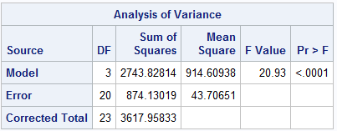
Example: MLR – Association
F_{ts} = 20.93, df1 = 3, df2 = 20
pf(20.93,3,20,lower.tail=FALSE) 2.212e-6
Notes:
Step 3. The test statistic. For this, we need the ANOVA table. [a]This is the result from SAS. [not in Video: The result from R is more complicated.]
[a]The test statistic is 20.93 [a]with numerator degrees of freedom of 3 and denominator degrees of freedom of 20.
[a]The p value is less than the resolution that SAS provides. [not in video: the p value is 2.212 x 10 to the negative 6.

Slide 73
Example: MLR – Association
p = 2.212e-6
reject H₀ 2.212e-6 < 0.05
The data does give strong support (p = 2.212e-6) to the claim that there is a linear relationship between the length of time that the cutting tool lasts and at least one of speed, feed, and depth.
Notes:
Step 4: The decision is reject H₀ because 0.0001 [not in video: 2.212 x 10 to the -6]
< 0.05
[a] Therefore, the data does give strong support (p < 0.0001[not in video: p = 2.212 x 10 to the -6]
) to the claim that there is a linear relationship between the length of time that the cutting tool lasts and at least one of speed, feed, and depth.
Note that we don’t know if all three of the variables are causing the relationship or fewer variables are. This is discussed next.

Slide 74
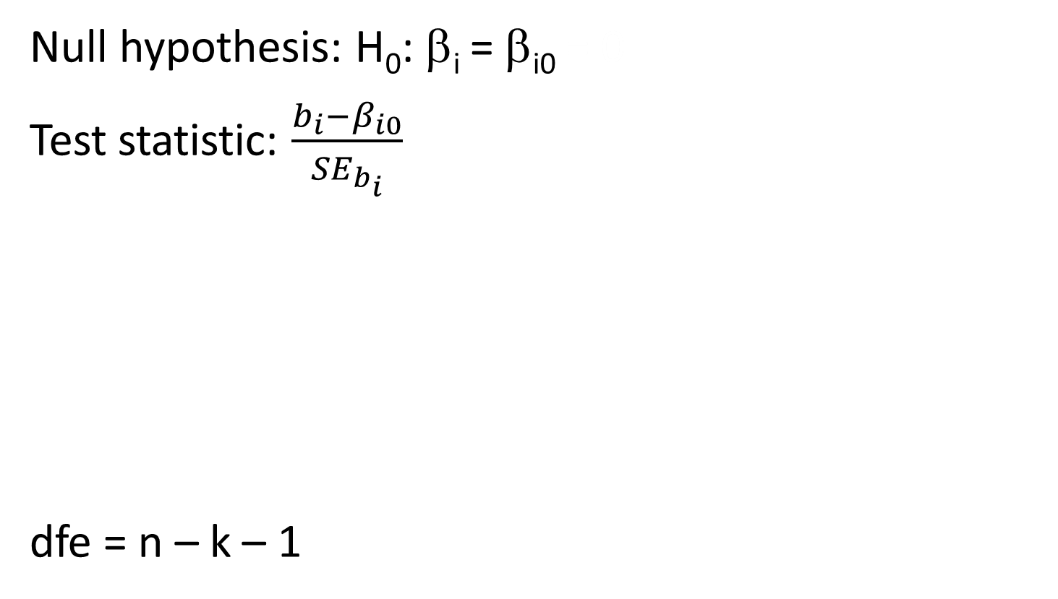
MLR Hypothesis t Test: Summary
Null hypothesis: H₀: β_{i} = β_{i0} = 0
Test statistic: $\frac{b_{i}−β_{i0}}{{SE}_{b_{i}}}$
dfe = n – k – 1
 | Alternative Hypothesis | P-Value
Upper-tailed | H_{a}: β_{i} > β_{i0} (0) | P(T ≥ t)
Lower-tailed | H_{a}: β_{i} < β_{i0} (0) | P(T ≤ t)
two-sided | H_{a}: β_{i} ≠ β_{i0} (0) | 2P(T ≥ |t|)
Notes:
Assuming that we have a significant result from the F test, we know that at least one of the explanatory variables is significant. However, we don’t know which one. Therefore, we need to perform the t tests on each of the k explanatory variables. Though you can also calculate the confidence interval for each of the explanatory variables, this is not done by default in SAS [not in video: R] so we will not be discussing this. If you are interested, the equation is in the book.
[a]The summary for each of the i explanatory variables is the same and is presented here. Again, the null value is read beta i 0. I am not going to provide the formula for standard error because we will not be calculating it by hand. However, the only variable in it is MSE so we use dfe as the degrees of freedom which is n – k – 1.
[a]Again, we will normally be determining if there is an association for the variable, so we will be doing a two-sided test with the null value of 0. This is what is presented in the default output from SAS.
However, there is an added complication here. This analysis is for only one of the variables. What is happening with the rest of the variables during the test? What we are assuming is that the rest of the parameters are in the model and we are determining if explanatory variable that we are testing contributes to the model. This assumption can cause problems in certain circumstances. which will be covered in much more detail in STAT 512.
An optional example follows.

Slide 75
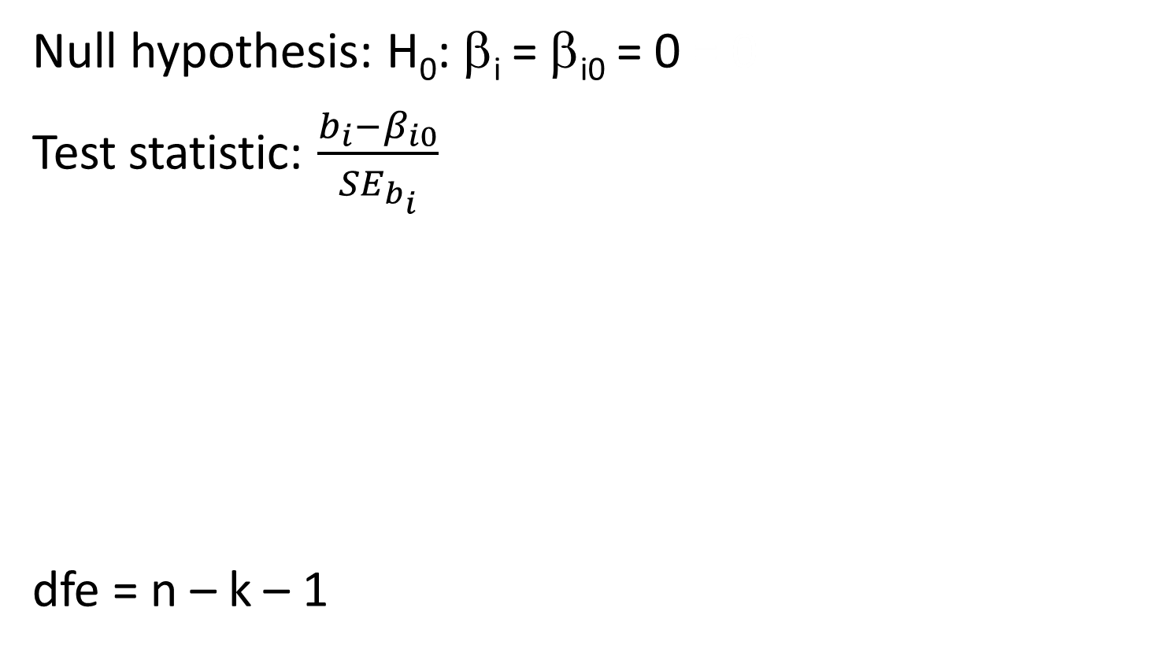
MLR Hypothesis t Test: Summary
Null hypothesis: H₀: β_{i} = β_{i0} = 0 = 0
Test statistic: $\frac{b_{i}−β_{i0}}{{SE}_{b_{i}}}$
dfe = n – k – 1
 | Alternative Hypothesis | P-Value
Upper-tailed | H_{a}: β_{i} > β_{i0} (0) | P(T ≥ t)
Lower-tailed | H_{a}: β_{i} < β_{i0} (0) | P(T ≤ t)
two-sided | H_{a}: β_{i} ≠ β_{i0} = 0 (0) | 2P(T ≥ |t|)
Notes:
Assuming that we have a significant result from the F test, we know that at least one of the explanatory variables is significant. However, we don’t know which one. Therefore, we need to perform the t tests on each of the k explanatory variables. Though you can also calculate the confidence interval for each of the explanatory variables, this is not done by default in SAS [not in video: R] so we will not be discussing this. If you are interested, the equation is in the book.
[a]The summary for each of the i explanatory variables is the same and is presented here. Again, the null value is read beta i 0. I am not going to provide the formula for standard error because we will not be calculating it by hand. However, the only variable in it is MSE so we use dfe as the degrees of freedom which is n – k – 1.
[a]Again, we will normally be determining if there is an association for the variable, so we will be doing a two-sided test with the null value of 0. This is what is presented in the default output from SAS.
However, there is an added complication here. This analysis is for only one of the variables. What is happening with the rest of the variables during the test? What we are assuming is that the rest of the parameters are in the model and we are determining if explanatory variable that we are testing contributes to the model. This assumption can cause problems in certain circumstances. which will be covered in much more detail in STAT 512.
An optional example follows.

Slide 76
Example: MLR – Explanatory
It is important to know how long a tool will last (min) in the industrial setting. The cutting tool in this study is used to cut a particular type and size of cold-rolled steel. The predictors of interest are x₁ = cutting speed (feet/min), x₂ = feed rate (in/revolution) and x₃ = depth of cut (in).
h) Which of the explanatory variables are linearly associated with the time that the tool will last at a significance level of 0.05?
Notes:
Example Optional Multiple Linear regression – Which variables are significant?
h) Which of the explanatory variables are linearly associated with the time that the tool will last at a significance level of 0.05?
Since there are three explanatory variables, speed, feed and depth, this question is asking for three different hypothesis tests. I will go through the hypothesis test completely for speed which is the first explanatory variable. Then I will quickly present the results for feed rate and depth and finally state the final result.

Slide 77
Example: MLR – Speed
Let β₁ be the true mean slope of speed assuming that feed and depth are constant.
H₀: β₁ = 0
There is no linear relationship between speed and the time.
H_{a}: β₁ ≠ 0
There is a linear relationship between speed and time.
Notes:
Step 1: We now only have one parameter, beta 1 which is the mean slope for speed.
[a]Step 2: Since we want to know if speed is linearly associated with the response variable, the null hypothesis is that beta 1 = 0. [a]This is the status quo or no linear relationship.
The alternative hypothesis is that beta 1 is not 0. [a]This is saying that speed and time are linearly associated.

Slide 78
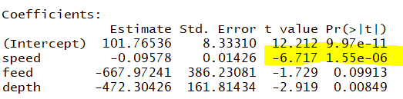
Example: MLR – Speed
t_{ts} = -6.72, df = 20
p = 2P(t > 6.72) = 1.55e-6
Notes:
Step 3. The test statistic. The table that provides this information in SAS is the same table that we used to write down the equation of the line.
[a]The test statistic is -6.72 [a] with degrees of freedom, dfe or 20. Do not use the degrees of freedom in this column. [This number is obtained elsewhere in the output.]
[a]The p value is less than the resolution that SAS provides. [not in video: p = 1.55e-6]

Slide 79
Example: MLR – Association
p = 1.55e-6
reject H₀ p = 1.55e-6 < 0.05
The data does give strong support (p = 1.55e-6) to the claim that there is a linear relationship between the length of time that the cutting tool lasts and speed assuming that feed and depth are included in the model.
Notes:
Step 4: The decision is reject H₀ because 0.0001 [not in video: 1.55e-6] < 0.05
[a] The data does give strong support (p < 0.0001 [not in video: 1.55e-6]) to the claim that there is a linear relationship between the length of time that the cutting tool lasts and speed assuming that feed and depth are included in the model.

Slide 80
Example: MLR – Feed/Depth
Feed | Depth
Let β₂ be the true mean slope of feed assuming that speed and depth are constant. | Let β₃ be the true mean slope of depth assuming that speed and feed are constant.
H₀: β₂ = 0 H_{a}: β₂ ≠ 0 | H₀: β₃ = 0 H_{a}: β₃ ≠ 0
Notes:
Now, I am going to briefly provide the details for Feed and Depth.
[a]Step 1. These are the same definitions of the parameters as was mentioned in the F test.
[a]Step 2. Again, we are interested in if the feed and depth are linearly associated with time so the null value is 0 and the alterative hypothesis is two-sided.

Slide 81
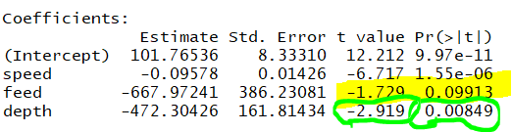
Example: MLR – Feed/Depth
Feed | Depth
t_{ts} = -1.73, df = 20 | t_{ts} = -2.93, df = 20
p = 2P(t > 1.73) = 0.0991 | p = 2P(t > 2.92) = 0.0085
Notes:
For Step 3, we just look at the appropriate rows in the same table. I have used yellow to indicate the feed values and green to indicate the depth values. The degrees of freedom is 20 for both of them.

Slide 82
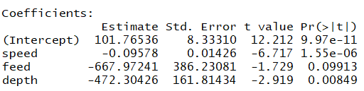
Example: MLR – Feed/Depth
Feed | Depth | Speed
p = 0.0991 | p = 0.0085 | p < 0.0001
Fail to reject H₀ | reject H₀ | reject H₀
0.0991 > 0.05 | 0.0085 < 0.05 | 0.0001 < 0.05
Not Linearly Associated | Linearly Associated | Linearly Associated
time = 101.77 – 0.096 speed – 472.30 depth
Notes:
Step 4: Feed is a fail to reject because the p value is 0.0991 while Depth is a reject because the p value is 0.0085. [a]Instead of including the complete conclusion in context, I have just stated whether the explanatory variables are linearly associated or not.
[a]So what is the final conclusion? Feed does not need to be in the model because it is not linearly associate with the time that the cutting tool will last. Therefore, we can state that depth of cut and cutting speed affect the time that the cutting tool will last, but the feed rate does not. [not in video: Therefore the equation of the line is the length of time that the tool lasts is 101.77 – 0.096 speed – 472.30 depth].

